Slide 1
Unit 201: Health and safety in building services engineering
Safe isolation

Slide 2
Safe isolation
The implications for carrying out (and not carrying out) the safe isolation procedure are as follows:
Self: Carrying out the safe isolation procedure ensures, as far as is reasonably practicable, that you should not receive an electric shock and burns. Conversely, not following the isolation procedure could result in you receiving an electric shock and burns that could be fatal.

Slide 3
Safe isolation
The implications for carrying out (and not carrying out) the safe isolation procedure are as follows:
Others: Other people in the installation could be affected by you not safely isolating the relevant part(s) of the installation. These ‘others’ could include the client and their employees, other trades people, client customers and members of the general public. They could suffer electrocution or harm caused by possible fire or explosion due to lack of awareness of potential danger. Also failing to carry out the isolation procedure could cause inconvenience to these ‘others’.

Slide 4
Safe isolation
The implications for carrying out (and not carrying out) the safe isolation procedure are as follows:
Building systems: Failure to carry out the safe isolation procedure could have implications for building systems including risk of damage to electrical equipment and/or building fabric, loss of essential services such as fire alarm systems, escape lighting and loss of data and or communication systems.

Slide 5
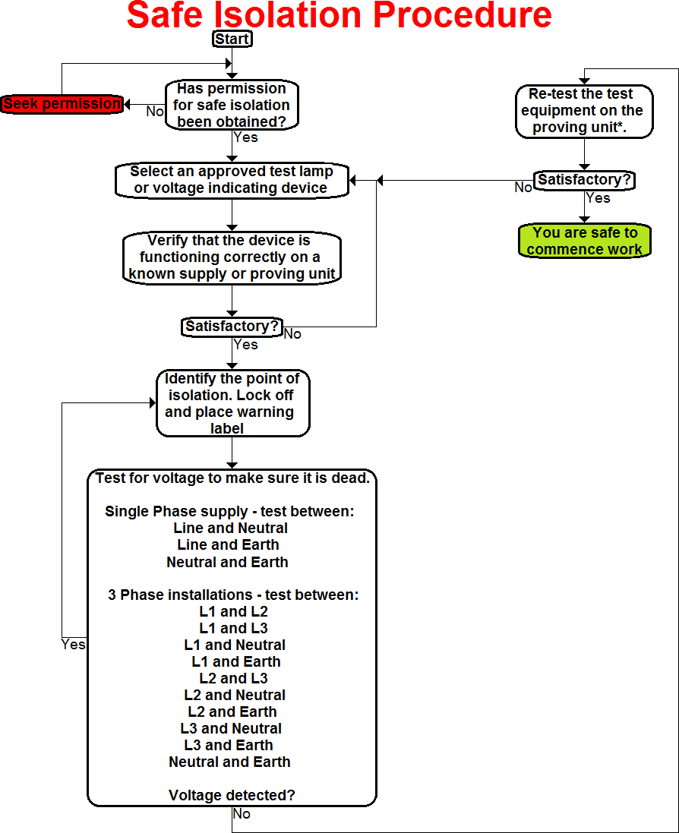
Safe isolation

Slide 6
Unit 201: Health and safety in building services engineering
The End

